Slide 1

10 Things To Do With Toes

Slide 2

Try The Grey Stuff, It’s Delicious
How To Cook Grey Matter

Slide 3

Tastes Like Chicken!
How To Cook Human For Non-Cannibals

Slide 4
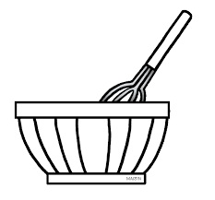
- A Cooks Guide To Cannibalism -

Slide 5
How To Cook Human – Volume One
Heads, Shoulders, Knees And Toes

Slide 6
How To Cook Human – Volume Two
And Eyes, And Ears, and Mouth and Nose

Slide 7

Brews That Bruise – A Witches Guide

Slide 8
Potions

Slide 9
. . . The Little Book of Curses . . .

Slide 10

A Beginner's Guide to Spellcasting

Slide 11

The Book Of The Dead

Slide 12
Dreams and Their Meanings

Slide 13
Hexes and Hauntings

Slide 14
The Sanderson Sisters – Heroes or Hacks?

Slide 15
Navigating at Night

Slide 16


Broom and Cat Management

